Slide 1
NMPC-ACADO IMPLEMTATIO UPDATES
16 May 2023
Michael Aramyan

Slide 2
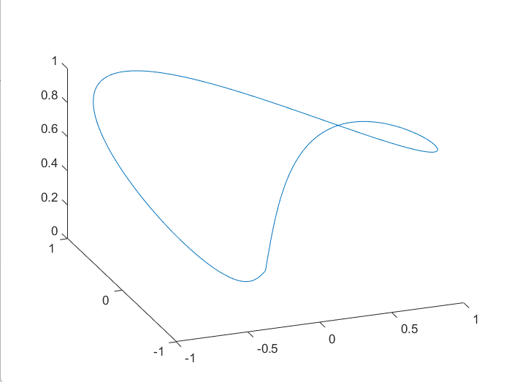
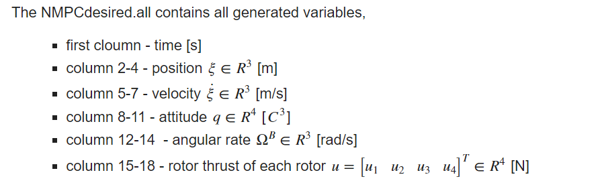
Generated Trajectory
Trajectory type - 3D figure 8 from CasAdi code
Duration - 15.005 s
sample time – 0.005 s
In total – 3001 sample point

Slide 3
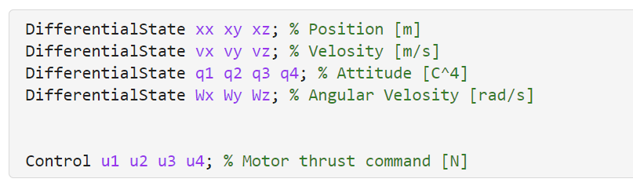
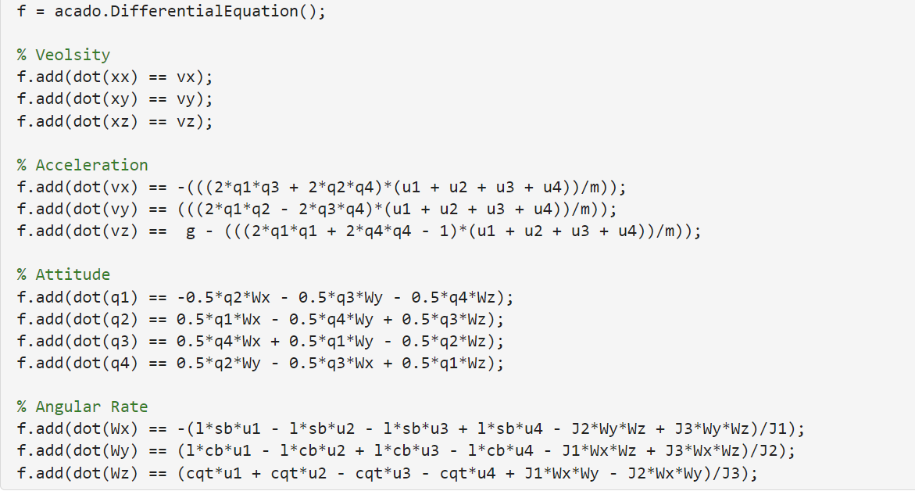
Dynamics

Slide 4
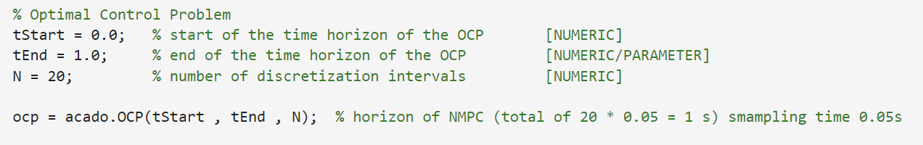
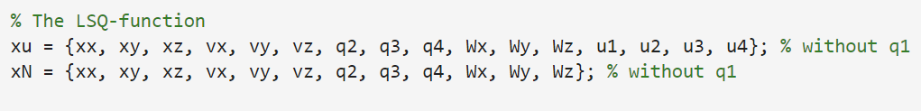
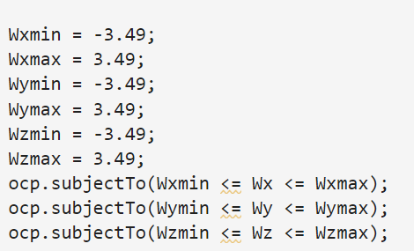
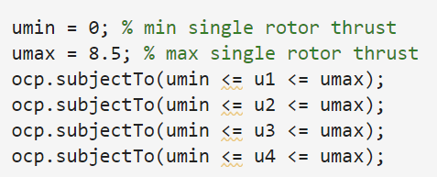
Optimal Control Problem
NMPC planning horizon – 1 s
NMPC sample time – 0.05 s
NMPC discretized samples – 20

Slide 5
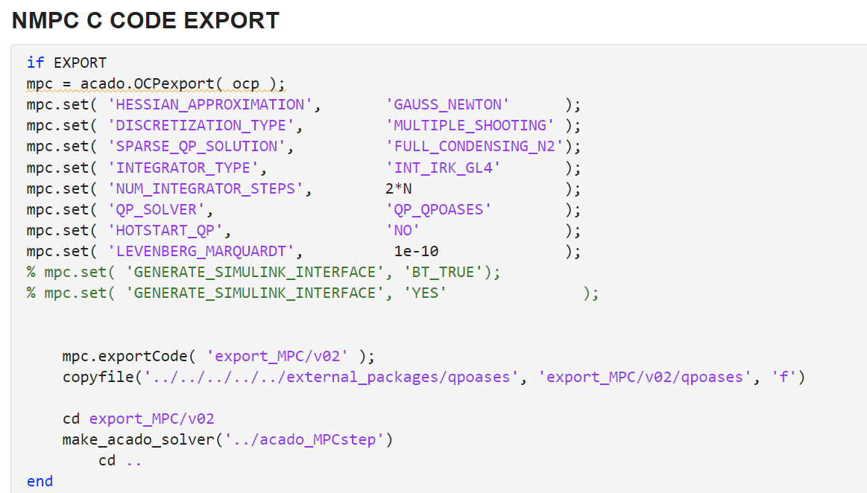
Code Generation

Slide 6
Plan to check the Generated Code
Generated Trajectory
Exported txt file
Generated C code - stand alone NMPC controller
Motor commands – trust (N) for each motor
Measurement – we used the data samples measurement from closed loop simulation
Exported txt file
Compared with control commands form the closed loop simulation
Note: Since closed-loop simulation sampled states of the system with had different sampling time we interpolated those sampled values to fit generated trajectory.

Slide 7



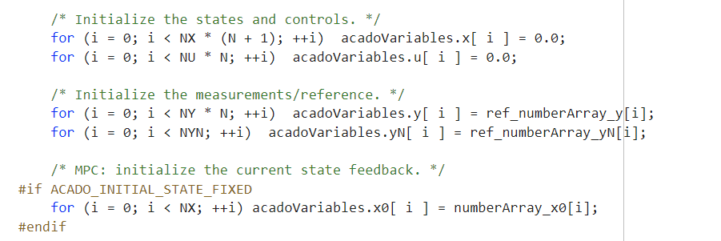
C code
Read txt. File and save them in arrays
Entering while loop for testing
Assigning values

Slide 8
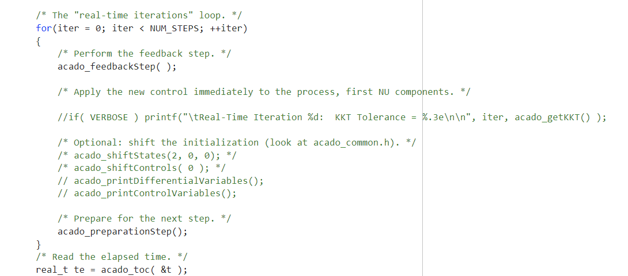
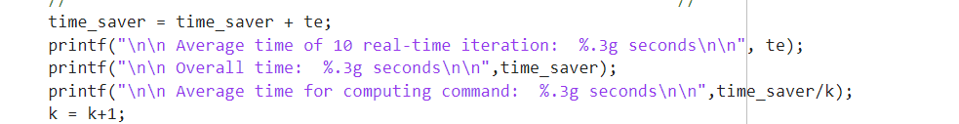

C code

Slide 9
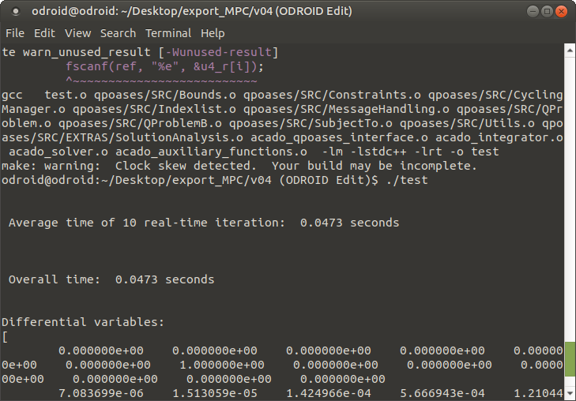
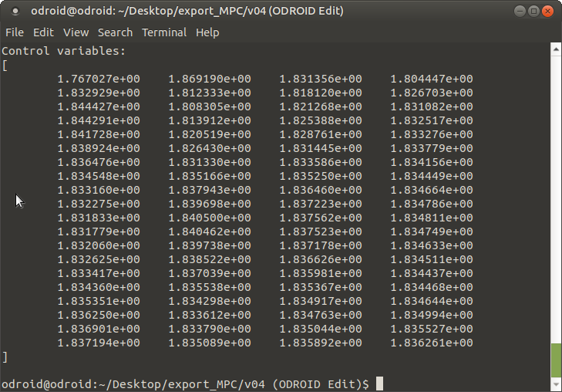
C code results

Slide 10
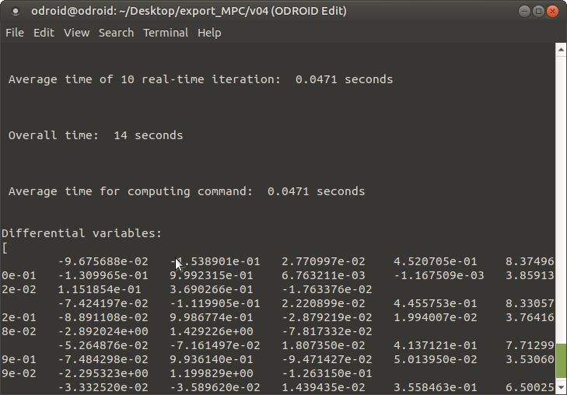
C code results

Slide 11
Future Plans
Save C code generated commands to the txt. file
Check commands from C code by running simulation (maybe Simulink)
Create ROS code based on generated C code

